Slide 1
Computer Architecture I
CS-GY-6133
Topic: Single Cycle MIPS Implementation
Instructor: Siddharth Garg

Slide 2
MIPS Instructions: R-Type
31
26
25
21
20
16
15
11
10
6
5
0
Op-code
(6-bits)
Rs
(5-bits)
Rt
(5-bits)
Rd
(5-bits)
Shamt
(5-bits)
funct
(6-bits)
000000 for all R-type instructions
Operand register identifiers
Result register identifier
Shift amount
Add: 100000 = 20_{hex}
Sub: 100010 = 22_{hex}
Or: 100101 = 25_{hex}
Sll: 000000 = 00_{hex}
add rs, rt, rd // R[rd] ← R[rs] + R[rd]; signed addition; trap on overflow
sub rs, rt, rd // R[rd] ← R[rs] - R[rt]; signed subtraction; trap on overflow
or rs, rt, rd // R[rd] ← R[rs] | R[rt]; bit-wise Boolean OR operation
sll rt, rd, shamt // R[rd] ← R[rt] << shamt; logical shift left
…..(many others)

Slide 3
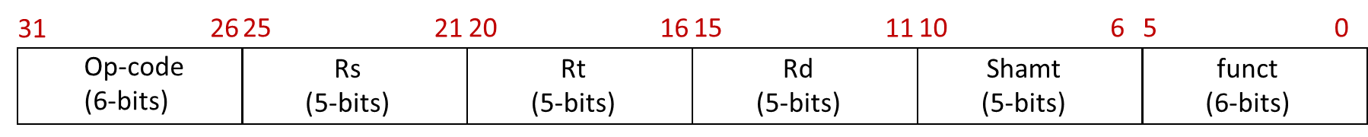
R-Type ALU Instructions
Adder
+4
ALU op
PC
Read Address
25:21
3
Rd Reg. 1
Read
Data 1
20:16
Instruction
Rd Reg. 2
ALU
result
15:11
Instruction Memory
Wrt Reg.
Read
Data 2
Wrt Data
Wrt Enable
“Datapath”
1

Slide 4
Example: Instruction at PC=0
4
Adder
+4
000000
00001
00010
00011
00000
010100
4
ALU op
0
PC
Read Address
00001
3
25:21
Rd Reg. 1
Read
Data 1
A21F FFB3
00010
20:16
Instruction
Rd Reg. 2
00011
ALU
result
15:11
BB33 CD53
Instruction Memory
Wrt Reg.
Read
Data 2
RF Contents
Wrt Data
0000 0000
00000
A21F FFB3
00001
Wrt Enable
BB33 CD53
00010
0
.
00011
1
1242 221E
.
A21F FFB3 | BB33 CD53
0001 0001
11111

Slide 5
MIPS Instructions: I-Type
31
26
25
21
20
16
15
0
Op-code
(6-bits)
Rs
(5-bits)
Rt
(5-bits)
Immediate
(16-bits)
addi: 8_{hex}
beq: 4_{hex}
ori: 25_{hex}
lw: 23_{hex}
Operand register
Result register
Immediate operand
(“PC relative”)
addi rs, rt, imm // R[rt] ← R[rs] + {SignExtend, imm}; MSB of imm is extended to 32 bits
beq rs, rt, imm // if{R[rs] == R[rt]} branch to PC + 4 + Target; (“PC relative”)
ori rs, rt, imm // R[rt] ← R[rs] | {ZeroExtend,imm}; bit-wise Boolean OR operation
lw rs, rt, imm // R[rt] ← Mem[ {SignExtendimm} + R[rs] ] (“Displaced/based”)
…..(many others)

Slide 6
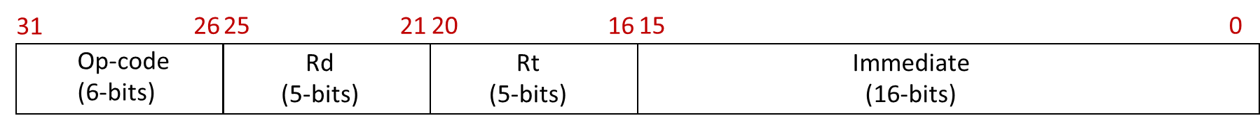
I-Type ALU Instructions
Adder
+4
ALU op
PC
Read Address
25:21
3
Rd Reg. 1
Read
Data 1
20:16
Instruction
Rd Reg. 2
20:16
ALU
result
15:11
Instruction Memory
Wrt Reg.
Read
Data 2
Wrt Data
15:0
Wrt Enable
32
1
Sign
Extend

Slide 7
Combined R-Type and
I-Type ALU Instructions
Adder
+4
ALU op
PC
Read Address
25:21
3
Rd Reg. 1
Read
Data 1
20:16
Instruction
Rd Reg. 2
ALU
result
Instruction Memory
15:11
Wrt Reg.
Read
Data 2
Wrt Data
I-Type?
a
Wrt Enable
a if (control = 1)
b if (control = 0)
1
I-Type?
MUX
15:0
Sign
Extend
b
control

Slide 8
Combined R-Type and
I-Type ALU Instructions
What about ALUop?
http://www-inst.eecs.berkeley.edu/~cs61c/resources/MIPS_Green_Sheet.pdf
ALU op
3
Add: 20_{hex} = 0010 0000
Addu: 21_{hex}= 0010 0001
Sub: 22_{hex}= 0010 0010
Subu: 23_{hex}= 0010 0011
And: 24_{hex}= 0010 0100
Or: 25_{hx}= 0010 0101
Nor: 27_{hex}= 0010 0111
Addi: 8_{hex}= 1000
Addiu: 9_{hex} = 1001
Andi: c_{hex}= 1100
Ori: d_{hex}= 1101
ALU
result
Function Field
OpCode
Last 3 bits of function field or Op Code uniquely identify the ALU functionality!

Slide 9
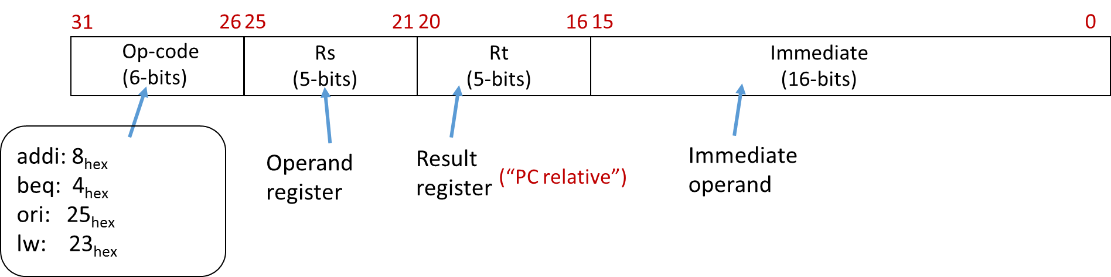
I-Type Load
Instructions
ALUOp = ?
25:21
3
Rd Reg. 1
Read
Data 1
Read Mem
Instruction
20:16
Rd Reg. 2
Instruction Fetch Part Not Shown
ALU
result
Address
15:11
Wrt Reg.
Read
Data 2
Wrt Data
I-Type?
Write
Data
Wrt Enable
Read Data
1
I-Type?
15:0
Sign
Extend
Data Memory
Write Mem

Slide 10
I-Type Load
Instructions
ALUOp = 001
25:21
3
IsLoad?
Rd Reg. 1
Read
Data 1
Read Mem
Instruction
20:16
Rd Reg. 2
ALU
result
Address
Instruction Fetch Part Not Shown
Wrt Reg.
Read
Data 2
15:11
Wrt Data
I-Type?
Write
Data
Wrt Enable
Read Data
1
I-Type?
15:0
Sign
Extend
Data Memory
Write Mem
0
IsLoad?

Slide 11
I-Type Store Instructions
sw rs, rt, imm //M[R[rs]+SignExtendimm] ← R[rt]
ALUOp = 001
25:21
3
isLoad?
Rd Reg. 1
Read
Data 1
Read Mem
Instruction
20:16
Rd Reg. 2
ALU
result
Address
Instruction Fetch Part Not Shown
Wrt Reg.
Read
Data 2
15:11
Wrt Data
I-Type?
Write
Data
Wrt Enable
Read Data
0
1
I-Type?
15:0
Sign
Extend
Data Memory
Write Mem
isStore?
In-Class Problem 2:
Did we miss something?
IsLoad?

Slide 12
Final Data-Path
(Excluding Control Flow Instructions)
ALUOp = 001
25:21
3
isLoad?
Rd Reg. 1
Read
Data 1
Read Mem
Instruction
20:16
Rd Reg. 2
ALU
result
Address
Instruction Fetch Part Not Shown
Wrt Reg.
Read
Data 2
15:11
Wrt Data
I-Type?
Write
Data
Wrt Enable
Read Data
!(IsStore?)
I-Type?
15:0
Sign
Extend
Data Memory
Write Mem
isStore?
IsLoad?

Slide 13
MIPS Instructions: J-Type
31
26
25
0
Op-code
(6-bits)
address
(26-bits)
j: 2_{hex}
jal: 3_{hex}
Immediate operand
j address // PC ← {PC+4[31:28], address, 00}

Slide 14
Control Flow
J-Type Control Flow
4 MSB bits taken from the 4 MSBs of PC+4
Next 26 bits taken from the “address” field
Last 2 bits are set to zero? (why?)
31
26
25
0
Op-code
(6-bits)
address
(26-bits)
j address // PC ← {PC+4[31:28], address, 00}, opcode=2_{hex}

Slide 15
J-Type Control Instruction
J-Type?
31:28
Concat
PC+4
00
Adder
+4
25:21
RF Onwards Not Shown
Rd Reg. 1
Read
Data 1
25:0
20:16
Rd Reg. 2
PC
Read Address
15:11
Wrt Reg.
Read
Data 2
Wrt Data
Instruction
I-Type?
Instruction Memory
Wrt Enable
What about WrtEnable?
!(J-Type?)
!(IsStore?)
0
15:0

Slide 16
Control Flow
I-Type Branch Instruction
First 30 MSBs from sign extended immediate
2 LSBs are always 0
31
26
25
21
20
16
15
0
Op-code
(6-bits)
Rs
(5-bits)
Rt
(5-bits)
Immediate
(16-bits)
beq rs, rt, imm // If (R[rs]==R[rt])
// PC ← PC + 4 + {SignExtendImm, 00},
// else
// PC ← PC + 4
// opcode=4_{hex}

Slide 17
NextPC? = function(J-Type?, IsBranch?, IsEq?)
3:1 MUX
PC+4
31:28
Adder
Concat
{SignExtendImm[29:0],00}
PC+4
00
Adder
+4
29:0
25:0
25:21
Rd Reg. 1
Read
Data 1
IsEq?
20:16
=
PC
Rd Reg. 2
Read Address
15:11
Wrt Reg.
Read
Data 2
Instruction
Wrt Data
Instruction Memory
I-Type?
Wrt Enable
!(IsBranch?)
I-Type?
15:0
Sign
Extend

Slide 18
IsLoad?
Generating Control Signals
(Control Path)
IsStore?
Decoder
I-Type?
ALUOp
Wrt Enable
ALUOp
25:21
3
isLoad?
Rd Reg. 1
Read
Data 1
Read Mem
Instruction
Inst[31:0]
20:16
Rd Reg. 2
ALU
result
Address
Instruction Fetch Part Not Shown
Wrt Reg.
Read
Data 2
15:11
Wrt Data
I-Type?
Write
Data
Wrt Enable
Read Data
I-Type?
15:0
Sign
Extend
Data Memory
Write Mem
isStore?
IsLoad?

Slide 19
IsLoad? = (Inst[31:26] == 100011)
IsStore? = (Inst[31:26] == 101011)
Decoder
I-Type? = (Inst[31:26] != 00000) && (Inst[31:26] != 00010)
ALUOp
Wrt Enable
ALUOp
25:21
3
isLoad?
Rd Reg. 1
Read
Data 1
Read Mem
Instruction
Inst[31:0]
20:16
Rd Reg. 2
ALU
result
Address
Instruction Fetch Part Not Shown
Wrt Reg.
Read
Data 2
15:11
Wrt Data
I-Type?
Write
Data
Wrt Enable
Read Data
I-Type?
15:0
Sign
Extend
Data Memory
Write Mem
isStore?
Control Path
IsLoad?

Slide 20
If (Inst[31:26] == 100011) | (Inst[31:26] == 101011)
ALUop = 001
Else
ALUop = Inst[2:0]
Decoder
ALUOp
Does this cover all cases?
ALUOp
25:21
3
isLoad?
Rd Reg. 1
Read
Data 1
Read Mem
Instruction
Inst[31:0]
20:16
Rd Reg. 2
ALU
result
Address
Instruction Fetch Part Not Shown
Wrt Reg.
Read
Data 2
15:11
Wrt Data
I-Type?
Write
Data
Wrt Enable
Read Data
I-Type?
15:0
Sign
Extend
Data Memory
Write Mem
isStore?
Control Path
IsLoad?

Slide 21
If (Inst[31:26] == 100011) | (Inst[31:26] == 101011)
ALUop = 001
Else If (Inst[31:26]==000000)
ALUop = Inst[2:0]
Else
ALUop = Inst[28:26]
Final Correct Implementation of ALU OP
Instruction Fetch Part Not Shown
Control Path

Slide 22
J-Type? = (Inst[31:26]==000010)
IsBranch? = (Inst[31:26]==000100)
If (IsStore? | IsBranch? | J-Type?)
WrtEnable = 0
Else
WrtEnable = 1
WrtEnable
Decoder
ALUOp
25:21
3
isLoad?
Rd Reg. 1
Read
Data 1
Read Mem
Instruction
Inst[31:0]
20:16
Rd Reg. 2
ALU
result
Address
Instruction Fetch Part Not Shown
Wrt Reg.
Read
Data 2
15:11
Wrt Data
I-Type?
Write
Data
Wrt Enable
Read Data
I-Type?
15:0
Sign
Extend
Data Memory
Write Mem
isStore?
Control Path
IsLoad?

Slide 23
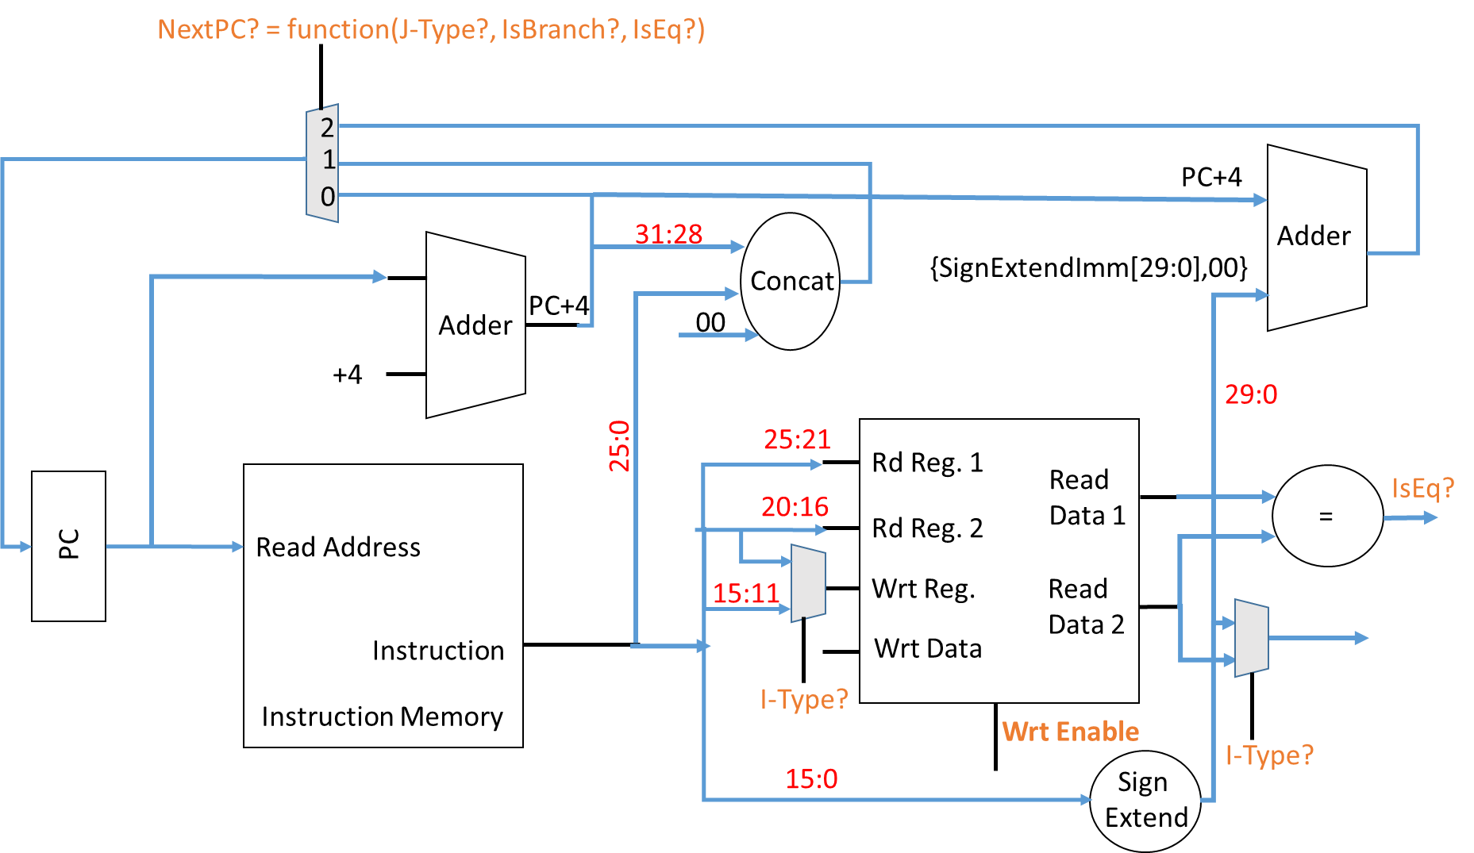
If (IsBranch? && isEQ?)
NextPC? = 2
else if (J-Type?)
NextPC? = 1
else
NextPC? = 0
In-Class Problem 3:
Write pseudo-code for NextPC?

Slide 24
Now Let’s Look at Lab 0
Class RF implements a register file
Registers contains a vector (array) of 32-bit values
class RF
{
public:
….
private:
vector<bitset<32>> Registers;
}

Slide 25
What is a “bitset”?
C++ standard template library (STL) class
Click here and go through some details:
www.cplusplus.com/reference/bitset/bitset

Slide 26
What is a “vector”?
C++ standard template library (STL) class

Slide 27
Register File
Function RF() is called every time a new object of class RF is instantiated
Sizes the RF to 32 regs, sets $r0 to 0
class RF
{
public:
….
RF(){
Registers.resize(32);
Registers[0] = bitset<32> (0);
}
}

Slide 28
Register File
ReadWrite function allows data to be written to and from the RF
class RF
{
public:
….
void ReadWrite(bitset<5> RdReg1, bitset<5> RdReg2, bitset<5> WrtReg, bitset<32> WrtData, bitset<1> WrtEnable)
{
// implement the function by yourself
}
}

Slide 29
Write Operation
ReadWrite function allows data to be written to and from the RF
class RF
{
public:
….
void ReadWrite(bitset<5> RdReg1, bitset<5> RdReg2, bitset<5> WrtReg, bitset<32> WrtData, bitset<1> WrtEnable)
{
// What gets updated?
}
}

Slide 30
Read Operation
ReadWrite function allows data to be written to and from the RF
class RF
{
public:
bitset<32> ReadData1, ReadData2;
void ReadWrite(bitset<5> RdReg1, bitset<5> RdReg2, bitset<5> WrtReg, bitset<32> WrtData, bitset<1> WrtEnable)
{
// How is the data read from RF accessed
}
}

Slide 31
Note about addu Operation
Simply performs the standard addition algorithm on 2 32-bit values
And ignores any carry-out
You can implement it bit-by-bit
Or by converting bitsets to unsigned long ints (32 bit unsigned numbers) and adding them
Hint: see what the C++ standard says about unsigned int addition

Slide 32
Note about subu Operation
Inverts every bit of the second operand, adds to the first operand, and adds +1
And ignores any carry-out
You can implement it bit-by-bit
Or by converting bitsets to unsigned long ints (32 bit unsigned numbers) and subtracting them
Hint: see what the C++ standard says about unsigned int subtraction

